Slide 1
Support Vector Machine
Data Science Assignment 6
March 2, 2022
Daksh Patel

Slide 2
Support Vector Machine
The objective of the support vector machine algorithm is to find a hyperplane (which works as boundary) in a N-dimensional space(where N is the number of features) that distinctly classifies the data points.
Different Type of Boundaries for Different number of Dimensions
Line for 2D
Plane for 3D
Hyper Plane for ND

Slide 3
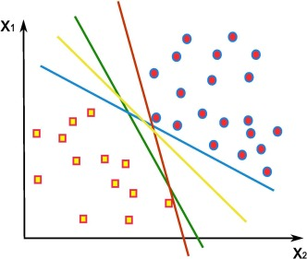
Support Vector Machine
For 2 features / 2 dimensions
Multiple vector are possible which can work as boundary for classification.
Our purpose is to find the vector which can classify the data in more generalized manner
Vector which has the highest margin (Distance between closest data point from vector) is the best fit for classification.

Slide 4
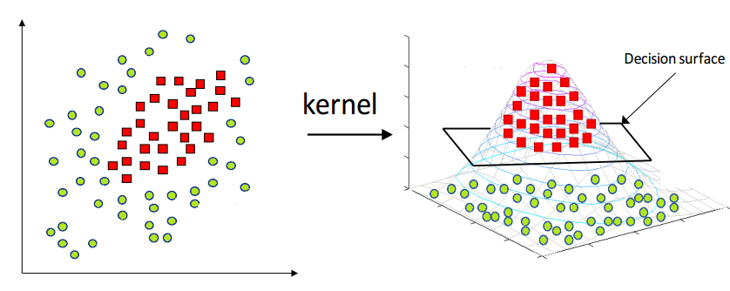
Kernel
The kernel projects the non-linearly separable data lower dimensions to linearly separable data in higher dimensions in such a way that data points belonging to different classes are allocated to different dimensions.

Slide 5
Thank You

